Slide 1


Password
Date: 02/10/2012
Time: 11:05:38
A
1
2
3
Session: LUNCH
B
4
5
6
C
7
8
9
LOGON
EXIT
D
CLEAR
0
OK

Slide 2
08/12/2014
Takeaway
Eat - In
Quick Food
18:35:36
DINNER
1
2
3
4
5
6
7
8
9
10
STAFF8
11
12
13
14
15
16
17
18
19
20
Table
Status
21
22
23
24
25
26
27
28
29
30
31
32
33
34
35
36
37
38
39
40
Table
Booking
Show
Order
-
-
-
-
-
-
-
-
-
-
-
-
-
-
-
-
-
-
-
-
Control
Panel
-
-
-
-
-
-
-
-
-
-
-
-
-
-
-
-
-
-
-
-
Logout
RESERVED
Eating
Billed & Unpaid
Being Processed
Paid & Eating
Empty
VIP

Slide 3
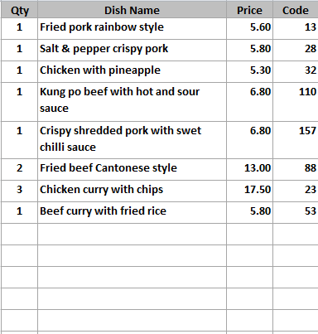
3
Table 2
Mixed hot platter
Mixed hot platter
Mixed hot platter
Mixed hot platter
Duck spring rolls
Duck spring rolls
Duck spring rolls
Duck spring rolls
Beef ginger and
spring onion
Beef ginger and
spring onion
Beef ginger and
spring onion
Beef ginger and
spring onion
Chicken yellow bean
cashew nuts
Chicken yellow bean
cashew nuts
Chicken yellow bean
cashew nuts
Chicken yellow bean
cashew nuts
MENU 1
Roast
Pork
Roast
Pork
Roast
Pork
Roast
Pork
Roast
Pork
SEARCH
MEAL
Szechuan
Szechuan
Szechuan
Szechuan
Szechuan
LANGUAGE
BBQ
Sauce
BBQ
Sauce
BBQ
Sauce
BBQ
Sauce
BBQ
Sauce
11
£67.95
18:48:30
86
+
-
REMOVE
ITEM
123
COURSE
Tomato
Tomato
Tomato
Tomato
Tomato
ORDER
CONTROL
FOOD
REMARK
+ / -
COURSE
DIVIDER
KEYPAD
Foo
Yung
Foo
Yung
Foo
Yung
Foo
Yung
Foo
Yung
PRINT
ORDER
TABLE FOOD
CHANGE
PAYMENT
CANCEL
ORDER
Tray Meal
Tray Meal
Tray Meal
Tray Meal
Tray Meal
Desktop
Logout
ACCEPT
Tray Meal
Tray Meal
Tray Meal
Tray Meal
Tray Meal

Slide 4

Changing number of persons
Current number of person is 3. To change the person number, press the person number
To change the table number, press the table number on the top

Slide 5
08/12/2014
1
11.80
2
31.50
3
15.50
4
111.80
5
37.80
18:35:36
00:30:38
00:30:38
00:30:38
00:30:38
00:30:38
DINNER
6
11.80
7
28.70
8
11.80
9
19.80
10
17.80
00:30:38
00:30:38
00:30:38
00:30:38
00:30:38
STAFF8
11
71.35
12
11.00
13
119.80
14
61.80
15
121.80
00:30:38
00:30:38
00:30:38
00:30:38
00:00:00
Table
Status
16
12.80
17
311.80
18
115.80
19
181.80
20
133.80
00:30:38
00:30:38
00:30:38
00:30:38
00:00:00
21
15.80
22
11.80
23
61.50
24
34.70
25
15.20
Table
Booking
00:30:38
00:30:38
00:30:38
00:30:38
00:30:38
26
115.80
27
121.80
28
11.85
29
119.80
30
111.80
00:30:38
00:30:38
00:30:38
00:30:38
00:30:38
Show
Order
31
211.80
32
711.80
33
117.80
34
121.80
35
00.00
00:30:38
00:30:38
00:30:38
00:30:38
00:00:00
36
00.00
37
00.00
38
00.00
39
00.00
40
00.00
00:00:00
00:00:00
00:00:00
00:00:00
00:00:00
Control
Panel
Logout
Empty
NA
Exit
Starter
Second
Main
Dessert

Slide 6
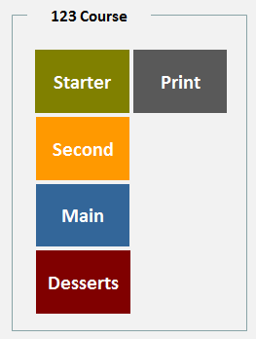
Table Status
Table Status – shows table number, total amount, and the timer for starter, second course, and main course
NA – for tables that are paid and still eating
Table
Status
The change of table status is triggered by user pressing different course. If you want to inform the kitchen to 走正餐 you can press the print button
If the waiter press the Print button, kitchen will get a message saying, e.g. Main course to go 廚房出正餐
Also change the colour of the table status button

Slide 7
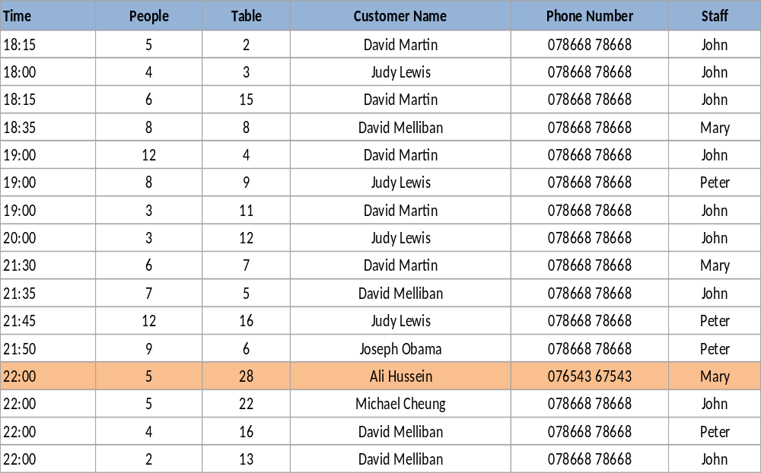
08/12/2014
Booking Details
18:35:36
Date
06/04/2014
From
22:00
To
23:00
People
5
DINNER
Table No.
28
Phone
076543 67543
Contact Name
Ali Hussien
STAFF8
Add New
Save
Table Blocking Time
1:00
Table
Status
Table
Booking
Show
Order
Control
Panel
Logout
Date
06/04/2014
Delete
Refresh
Exit

Slide 8
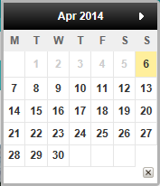
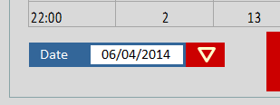
Table Booking
Default dining period 2 hours (configurable at Eat In setting page)
30 minute before reserve the table by colouring it with pink reserved button (Configurable)
Table
Booking
Table
Status
Select date to view booking information

Slide 9
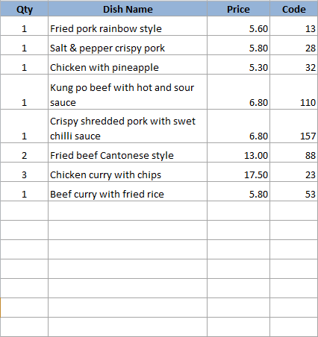
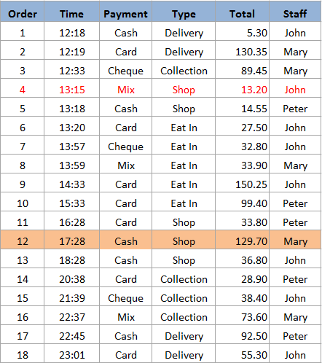
Show Order
Current Time
Current Date
18:35:36
08/12/2014
Print
Receipt
Print
Bill
Print
Kitchen
Paper
Print
Account
Summary
Delivery Charge : 2.50
Show
All
Collect
Delivery
Shop
Eat In
Cust
Info
Discount : 3.80
Surcharge : 1.00
Change
Payment
Edit
Order
Show
Driver
D/C
Exit
Items
11
Total Amount
129.70

Slide 10
Control Panel
System Setting
System
Configuration
User
Maintenance
Data Manager
Compact
Database
Computer
Address
Shift Code
Takeaway & Quick Dining Setting
Takeaway
Configuration
Menu Category
Menu Item
Manage
Menu Set
Extra Menu
Edit
Order Control
Department
Code
Table Setup
Print Setup
Driver
Setup
Eat In Setting
Eat-In
Configuration
Menu Category
Menu Item
Manage
Menu Set
Extra Menu
Edit
Order Control
Department
Code
Table Setup
Printer
Order Entry
Print Setup
Reporting
Account
Summary
Reports
System
Control
Exit

Slide 11
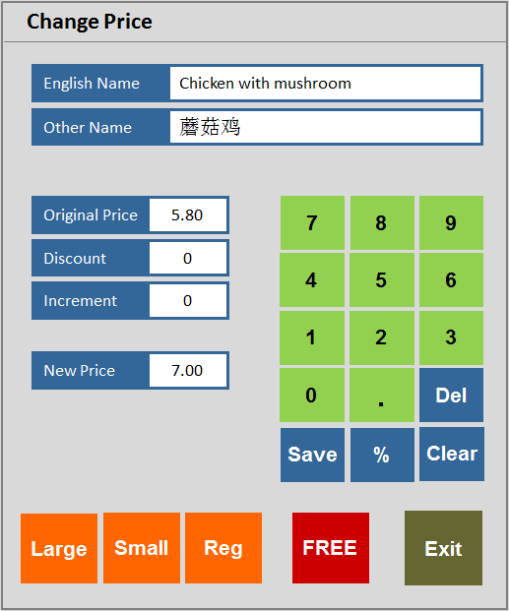
3
Table 2
Mixed hot platter
Mixed hot platter
Mixed hot platter
Mixed hot platter
Duck spring rolls
Duck spring rolls
Duck spring rolls
Duck spring rolls
Beef ginger and
spring onion
Beef ginger and
spring onion
Beef ginger and
spring onion
Beef ginger and
spring onion
Chicken yellow bean
cashew nuts
Chicken yellow bean
cashew nuts
Chicken yellow bean
cashew nuts
Chicken yellow bean
cashew nuts
MENU 1
Roast
Pork
Roast
Pork
Roast
Pork
Roast
Pork
Roast
Pork
SEARCH
MEAL
Szechuan
Szechuan
Szechuan
Szechuan
Szechuan
LANGUAGE
BBQ
Sauce
BBQ
Sauce
BBQ
Sauce
BBQ
Sauce
BBQ
Sauce
11
£67.95
18:48:30
86
+
-
REMOVE
ITEM
123
COURSE
Tomato
Tomato
Tomato
Tomato
Tomato
ORDER
CONTROL
FOOD
REMARK
+ / -
COURSE
DIVIDER
KEYPAD
Foo
Yung
Foo
Yung
Foo
Yung
Foo
Yung
Foo
Yung
PRINT
ORDER
TABLE FOOD
CHANGE
PAYMENT
CANCEL
ORDER
Tray Meal
Tray Meal
Tray Meal
Tray Meal
Tray Meal
Desktop
Logout
ACCEPT
Tray Meal
Tray Meal
Tray Meal
Tray Meal
Tray Meal

Slide 12
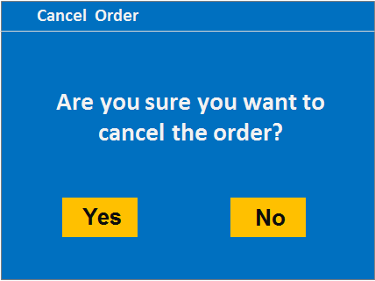
3
Table 2
Mixed hot platter
Mixed hot platter
Mixed hot platter
Mixed hot platter
Duck spring rolls
Duck spring rolls
Duck spring rolls
Duck spring rolls
Beef ginger and
spring onion
Beef ginger and
spring onion
Beef ginger and
spring onion
Beef ginger and
spring onion
Chicken yellow bean
cashew nuts
Chicken yellow bean
cashew nuts
Chicken yellow bean
cashew nuts
Chicken yellow bean
cashew nuts
MENU 1
Roast
Pork
Roast
Pork
Roast
Pork
Roast
Pork
Roast
Pork
SEARCH
MEAL
Szechuan
Szechuan
Szechuan
Szechuan
Szechuan
LANGUAGE
BBQ
Sauce
BBQ
Sauce
BBQ
Sauce
BBQ
Sauce
BBQ
Sauce
11
£67.95
18:48:30
86
+
-
REMOVE
ITEM
123
COURSE
Tomato
Tomato
Tomato
Tomato
Tomato
ORDER
CONTROL
FOOD
REMARK
+ / -
COURSE
DIVIDER
KEYPAD
Foo
Yung
Foo
Yung
Foo
Yung
Foo
Yung
Foo
Yung
PRINT
ORDER
TABLE FOOD
CHANGE
PAYMENT
CANCEL
ORDER
Tray Meal
Tray Meal
Tray Meal
Tray Meal
Tray Meal
Desktop
Logout
ACCEPT
Tray Meal
Tray Meal
Tray Meal
Tray Meal
Tray Meal

Slide 13
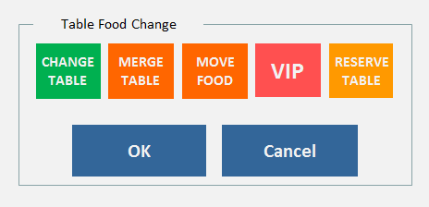
3
Table 2
Mixed hot platter
Mixed hot platter
Mixed hot platter
Mixed hot platter
Duck spring rolls
Duck spring rolls
Duck spring rolls
Duck spring rolls
Beef ginger and
spring onion
Beef ginger and
spring onion
Beef ginger and
spring onion
Beef ginger and
spring onion
Chicken yellow bean
cashew nuts
Chicken yellow bean
cashew nuts
Chicken yellow bean
cashew nuts
Chicken yellow bean
cashew nuts
MENU 1
Roast
Pork
Roast
Pork
Roast
Pork
Roast
Pork
Roast
Pork
SEARCH
MEAL
Szechuan
Szechuan
Szechuan
Szechuan
Szechuan
LANGUAGE
BBQ
Sauce
BBQ
Sauce
BBQ
Sauce
BBQ
Sauce
BBQ
Sauce
11
£67.95
18:48:30
86
+
-
REMOVE
ITEM
123
COURSE
Tomato
Tomato
Tomato
Tomato
Tomato
ORDER
CONTROL
FOOD
REMARK
+ / -
COURSE
DIVIDER
KEYPAD
Foo
Yung
Foo
Yung
Foo
Yung
Foo
Yung
Foo
Yung
PRINT
ORDER
TABLE FOOD
CHANGE
PAYMENT
CANCEL
ORDER
Tray Meal
Tray Meal
Tray Meal
Tray Meal
Tray Meal
Desktop
Logout
ACCEPT
Tray Meal
Tray Meal
Tray Meal
Tray Meal
Tray Meal

Slide 14
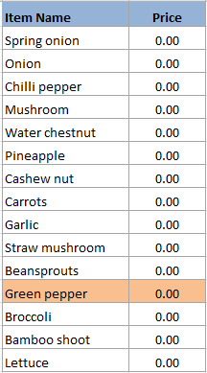
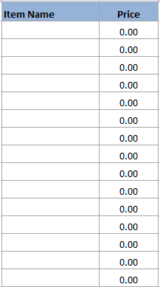
Taste Handling
Taste Item
Drink Item
Vegetable
LESS
Vegetable 2
Bean
ADD
Meat
Seafood
WITHOUT
Select From
Main Menu
Sauce
CHANGE
Taste
Fruit
Cooking
Others
Clear
Exit

Slide 15
Change Table
3
5
6
7
8
10
11
12
13
14
15
16
17
18
19
20
21
22
23
24
26
27
28
29
30
31
32
33
35
36
37
38
39
-
-
-
-
-
-
-
-
-
-
-
-
-
-
-
-
-
-
-
-
-
-
-
-
-
-
-
-
-
-
-
-
-
-
-
-
-
-
-
-
Cancel
Exit

Slide 16
Merge Table
1
2
4
9
25
40
RESERVED
Eating
Billed & Unpaid
Paid & Eating
Cancel
Exit

Slide 17
Order Control
Cook when told
Cook now
As starter
As 2nd course
As main course
Hurry please cook
Missing pls cook
Cancel order
Sauce separate
With desserts
Split 2 plates
Split 3 plates
All separate
As takeaway
Cook first
Smaller portion
Clear
Switch
Language
Exit

Slide 18
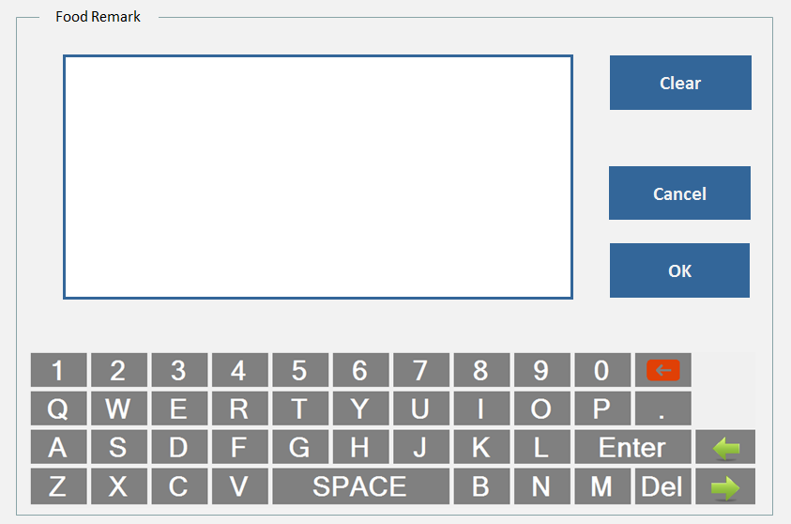
3
Table 2
Mixed hot platter
Mixed hot platter
Mixed hot platter
Mixed hot platter
Duck spring rolls
Duck spring rolls
Duck spring rolls
Duck spring rolls
Beef ginger and
spring onion
Beef ginger and
spring onion
Beef ginger and
spring onion
Beef ginger and
spring onion
Chicken yellow bean
cashew nuts
Chicken yellow bean
cashew nuts
Chicken yellow bean
cashew nuts
Chicken yellow bean
cashew nuts
MENU 1
Roast
Pork
Roast
Pork
Roast
Pork
Roast
Pork
Roast
Pork
SEARCH
MEAL
Szechuan
Szechuan
Szechuan
Szechuan
Szechuan
LANGUAGE
BBQ
Sauce
BBQ
Sauce
BBQ
Sauce
BBQ
Sauce
BBQ
Sauce
11
£67.95
18:48:30
86
+
-
REMOVE
ITEM
123
COURSE
Tomato
Tomato
Tomato
Tomato
Tomato
ORDER
CONTROL
FOOD
REMARK
+ / -
COURSE
DIVIDER
KEYPAD
Foo
Yung
Foo
Yung
Foo
Yung
Foo
Yung
Foo
Yung
PRINT
ORDER
TABLE FOOD
CHANGE
PAYMENT
CANCEL
ORDER
Tray Meal
Tray Meal
Tray Meal
Tray Meal
Tray Meal
Desktop
Logout
ACCEPT
Tray Meal
Tray Meal
Tray Meal
Tray Meal
Tray Meal

Slide 19
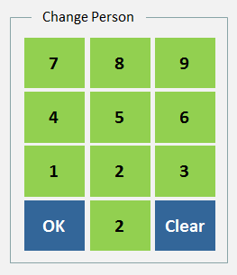
3
Table 2
Mixed hot platter
Mixed hot platter
Mixed hot platter
Mixed hot platter
Duck spring rolls
Duck spring rolls
Duck spring rolls
Duck spring rolls
Beef ginger and
spring onion
Beef ginger and
spring onion
Beef ginger and
spring onion
Beef ginger and
spring onion
Chicken yellow bean
cashew nuts
Chicken yellow bean
cashew nuts
Chicken yellow bean
cashew nuts
Chicken yellow bean
cashew nuts
MENU 1
Roast
Pork
Roast
Pork
Roast
Pork
Roast
Pork
Roast
Pork
SEARCH
MEAL
Szechuan
Szechuan
Szechuan
Szechuan
Szechuan
LANGUAGE
BBQ
Sauce
BBQ
Sauce
BBQ
Sauce
BBQ
Sauce
BBQ
Sauce
11
£67.95
18:48:30
86
+
-
REMOVE
ITEM
123
COURSE
Tomato
Tomato
Tomato
Tomato
Tomato
ORDER
CONTROL
FOOD
REMARK
+ / -
COURSE
DIVIDER
KEYPAD
Foo
Yung
Foo
Yung
Foo
Yung
Foo
Yung
Foo
Yung
PRINT
ORDER
TABLE FOOD
CHANGE
PAYMENT
CANCEL
ORDER
Tray Meal
Tray Meal
Tray Meal
Tray Meal
Tray Meal
Desktop
Logout
ACCEPT
Tray Meal
Tray Meal
Tray Meal
Tray Meal
Tray Meal

Slide 20
3
Table 2
Mixed hot platter
Mixed hot platter
Mixed hot platter
Mixed hot platter
Duck spring rolls
Duck spring rolls
Duck spring rolls
Duck spring rolls
Beef ginger and
spring onion
Beef ginger and
spring onion
Beef ginger and
spring onion
Beef ginger and
spring onion
Chicken yellow bean
cashew nuts
Chicken yellow bean
cashew nuts
Chicken yellow bean
cashew nuts
Chicken yellow bean
cashew nuts
MENU 1
Roast
Pork
Roast
Pork
Roast
Pork
Roast
Pork
Roast
Pork
SEARCH
MEAL
Szechuan
Szechuan
Szechuan
Szechuan
Szechuan
LANGUAGE
BBQ
Sauce
BBQ
Sauce
BBQ
Sauce
BBQ
Sauce
BBQ
Sauce
11
£67.95
18:48:30
86
+
-
REMOVE
ITEM
123
COURSE
Tomato
Tomato
Tomato
Tomato
Tomato
ORDER
CONTROL
FOOD
REMARK
+ / -
COURSE
DIVIDER
KEYPAD
Foo
Yung
Foo
Yung
Foo
Yung
Foo
Yung
Foo
Yung
PRINT
ORDER
TABLE FOOD
CHANGE
PAYMENT
CANCEL
ORDER
Tray Meal
Tray Meal
Tray Meal
Tray Meal
Tray Meal
Desktop
Logout
ACCEPT
Tray Meal
Tray Meal
Tray Meal
Tray Meal
Tray Meal

Slide 21
Print Order
PRINT
ORDER
PRINT ORDER BUTTON 上菜紙
Prints everything on the current order, including drinks and all departments
This paper enable the waiter to check what items that table had ordered and cross out those already been served

Slide 22
3
Table 2
Mixed hot platter
Mixed hot platter
Mixed hot platter
Mixed hot platter
Press this button to reserve the table
Colour will change from green to orange
Duck spring rolls
Duck spring rolls
Duck spring rolls
Duck spring rolls
RESERVED
Beef ginger and
spring onion
Beef ginger and
spring onion
Beef ginger and
spring onion
Beef ginger and
spring onion
Chicken yellow bean
cashew nuts
Chicken yellow bean
cashew nuts
Chicken yellow bean
cashew nuts
Chicken yellow bean
cashew nuts
4
MENU 1
Roast
Pork
Roast
Pork
Roast
Pork
Roast
Pork
Roast
Pork
SEARCH
MEAL
Szechuan
Szechuan
Szechuan
Szechuan
Szechuan
LANGUAGE
BBQ
Sauce
BBQ
Sauce
BBQ
Sauce
BBQ
Sauce
BBQ
Sauce
11
£67.95
18:48:30
86
+
-
REMOVE
ITEM
123
COURSE
Tomato
Tomato
Tomato
Tomato
Tomato
ORDER
CONTROL
FOOD
REMARK
+ / -
COURSE
DIVIDER
KEYPAD
Foo
Yung
Foo
Yung
Foo
Yung
Foo
Yung
Foo
Yung
PRINT
ORDER
TABLE FOOD
CHANGE
PAYMENT
CANCEL
ORDER
Tray Meal
Tray Meal
Tray Meal
Tray Meal
Tray Meal
Desktop
Logout
ACCEPT
Tray Meal
Tray Meal
Tray Meal
Tray Meal
Tray Meal

Slide 23
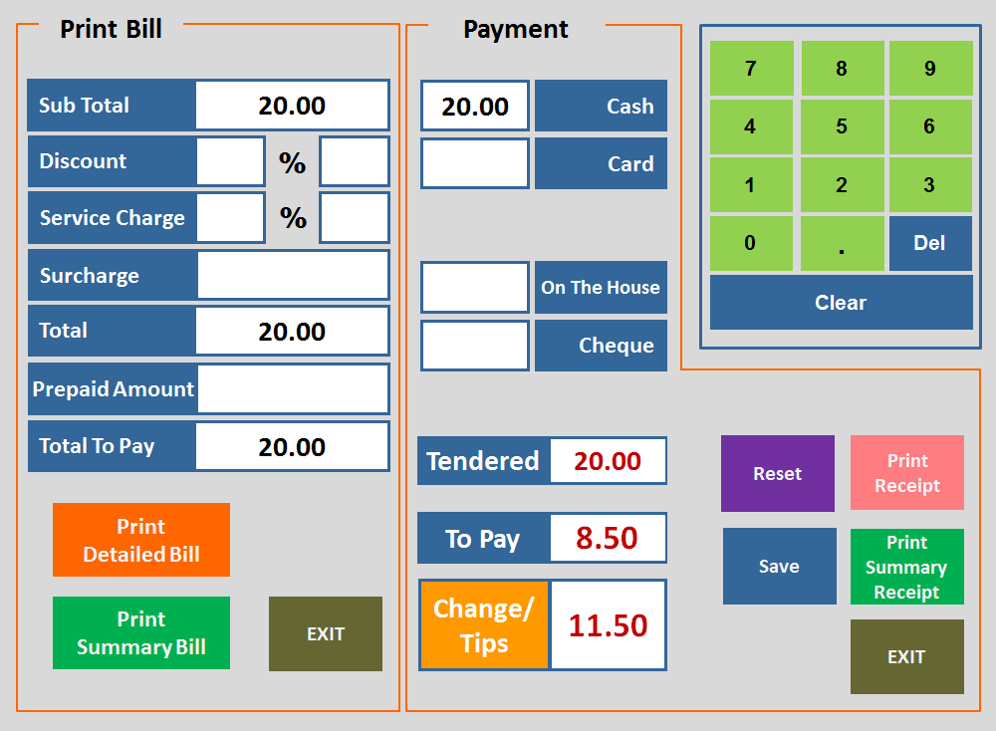
3
Table 2
Mixed hot platter
Mixed hot platter
Mixed hot platter
Mixed hot platter
Duck spring rolls
Duck spring rolls
Duck spring rolls
Duck spring rolls
Beef ginger and
spring onion
Beef ginger and
spring onion
Beef ginger and
spring onion
Beef ginger and
spring onion
Chicken yellow bean
cashew nuts
Chicken yellow bean
cashew nuts
Chicken yellow bean
cashew nuts
Chicken yellow bean
cashew nuts
MENU 1
Roast
Pork
Roast
Pork
Roast
Pork
Roast
Pork
Roast
Pork
SEARCH
MEAL
Szechuan
Szechuan
Szechuan
Szechuan
Szechuan
LANGUAGE
BBQ
Sauce
BBQ
Sauce
BBQ
Sauce
BBQ
Sauce
BBQ
Sauce
11
£67.95
18:48:30
86
+
-
REMOVE
ITEM
123
COURSE
Tomato
Tomato
Tomato
Tomato
Tomato
ORDER
CONTROL
FOOD
REMARK
+ / -
COURSE
DIVIDER
KEYPAD
Foo
Yung
Foo
Yung
Foo
Yung
Foo
Yung
Foo
Yung
PRINT
ORDER
TABLE FOOD
CHANGE
PAYMENT
CANCEL
ORDER
Tray Meal
Tray Meal
Tray Meal
Tray Meal
Tray Meal
Desktop
Logout
ACCEPT
Tray Meal
Tray Meal
Tray Meal
Tray Meal
Tray Meal

Slide 24
END
(Slides beyond this page are for references only)

Slide 25
Current number of person is 3. To change the person number, press the person number
To change the table number, press the table number on the top
3
Table 2
[32] Chicken Curry
Roast
Pork
Roast
Pork
Roast
Pork
[33] Chicken with Mushroom
Szechuan
Szechuan
Szechuan
[34] Chicken Green Pepper
& Black Bean Sauce
BBQ
Sauce
BBQ
Sauce
BBQ
Sauce
[35] Chicken with Cashew
Nuts
[36] Chicken with Lemon
Sauce
Tomato
Tomato
Tomato
[37] Chicken with Black
Pepper
Foo
Yung
Foo
Yung
Foo
Yung
[38] Chicken with Pineapple
Tray Meal
Tray Meal
Tray Meal
[39] Chicken with Bamboo
Shoots & Water Chestnuts
[40] Chicken with Chinese
Mushroom
Foo
Yung
Foo
Yung
Foo
Yung
11
£67.95
18:48:30
86
[41] Chicken in Chinese Style
Tray Meal
Tray Meal
Tray Meal
+
-
REMOVE
ITEM
[42] Chicken with Yellow Bean
Sauce
Foo
Yung
Foo
Yung
Foo
Yung
[43] Chicken in Thai Red Curry
ORDER
CONTROL
FOOD
REMARK
+ / -
COURSE
DIVIDER
[44] Chicken with Yellow Bean
Sauce
Tray Meal
Tray Meal
Tray Meal
PRINT
ORDER
TABLE FOOD
CHANGE
PAYMENT
[45] Chicken with Yellow Bean
Sauce
Desktop
Logout
ACCEPT
MENU 1
SEARCH
MEAL
LANGUAGE
123
COURSE
KEYPAD
CANCEL
ORDER

Slide 26
Print Bill
Payment
7
8
9
Sub Total
20.00
20.00
Cash
4
5
6
Discount
%
Card
1
2
3
Service Charge
%
0
.
Del
Surcharge
On The House
Clear
Total
20.00
Cheque
Prepaid Amount
Total To Pay
20.00
Tendered
20.00
Reset
Print
Receipt
Print
Detailed Bill
To Pay
8.50
Save
Print
Summary
Receipt
Change/
Tips
11.50
Print
Summary Bill
EXIT
EXIT

Slide 27
Print Bill
Payment
Sub Total
20.00
20.00
Cash
Tendered
20.00
Discount
%
Card
To Pay
8.50
Service Charge
%
Change/
Tips
11.50
Surcharge
On The House
Total
20.00
Cheque
Prepaid Amount
Total To Pay
20.00
7
8
9
4
5
6
Print Bill
1
2
3
Reset
Print
Receipt
0
.
Del
Clear
Save
EXIT

Slide 28
Payment
20.00
Cash
7
8
9
Card
4
5
6
Surcharge: 0.00
1
2
3
On The House
0
.
Del
Cheque
Save
%
Clear
Save
Reset
Tendered
20.00
To Pay
8.50
Change/
Tips
11.50
Print
Receipt
EXIT

Slide 29
Print Bill
Sub Total
20.00
Discount
%
Service Charge
%
Surcharge
Print Bill
Total
20.00
Prepaid Amount
Total To Pay
20.00
7
8
9
Exit
4
5
6
1
2
3
0
.
Del
Save
%
Clear

Slide 30
Change Person
7
8
9
Print
4
5
6
1
2
3
123 Course
OK
2
Clear
Starter
Print
Second
Main
Desserts

Slide 31
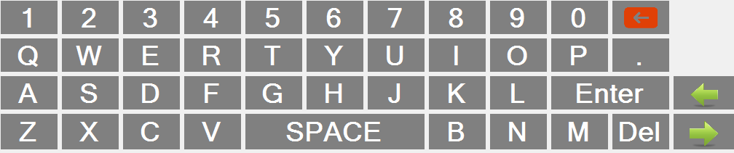
Food Remark
Clear
Cancel
OK

Slide 32
Table Food Change
CHANGE
TABLE
MERGE
TABLE
MOVE
FOOD
VIP
RESERVE
TABLE
OK
Cancel
Exit

